Slide 1
Climate Change and Food Security:
Examining the Impact of the Meat Sector
By- CLIMATE CRUSADERS (Team-2)
Anmol Negi Ashwina Prasad
Ishita Singh
Paridhi Gupta
Aayush Kukreja

Slide 2
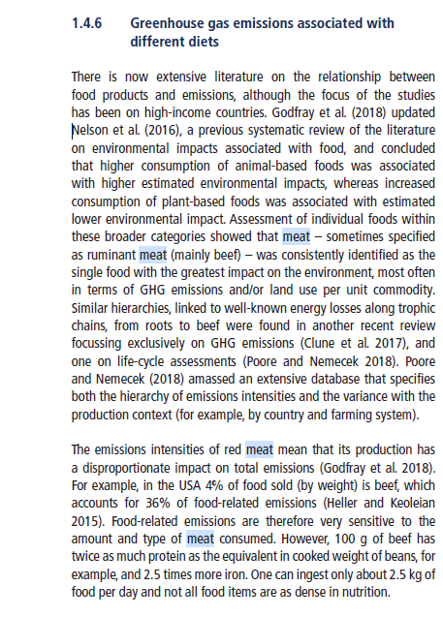
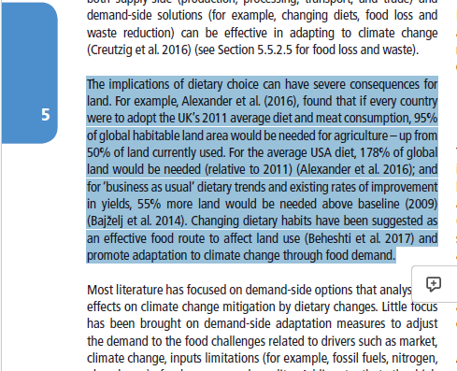

Slide 3
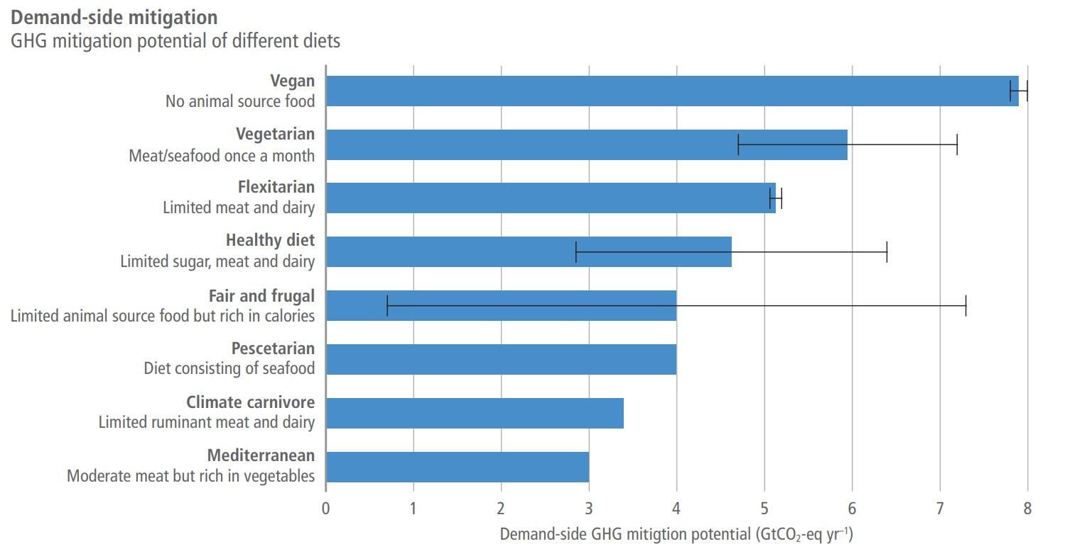

Slide 4
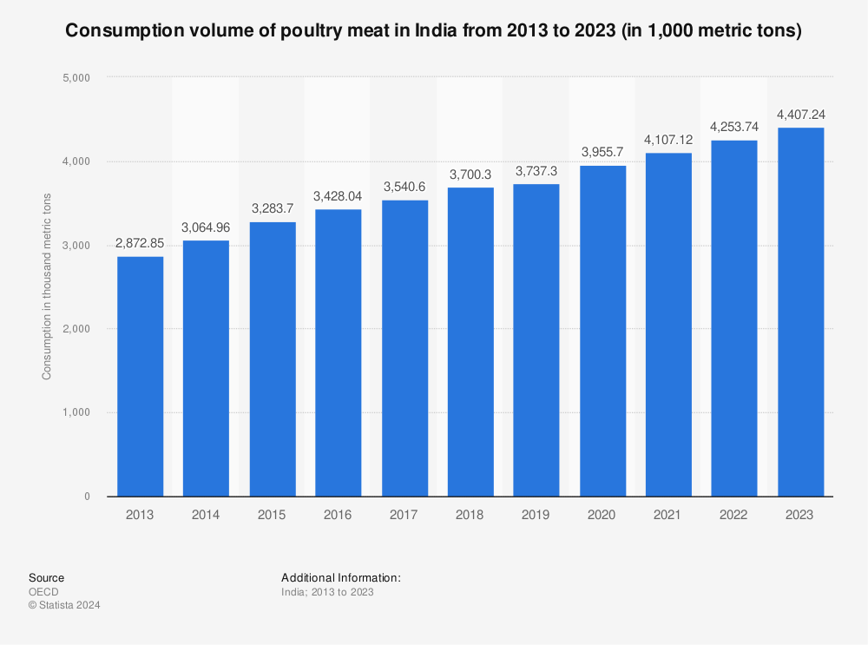

Slide 5
Impacts of the Meat Industry on Climate
Rise in Global Temperature
excessive meat consumption across the globe leads to-
AntiMicrobial Resistance
Problems
Deforestation

Slide 6
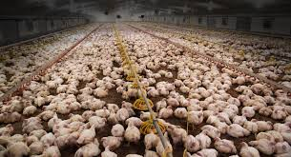
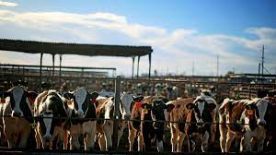
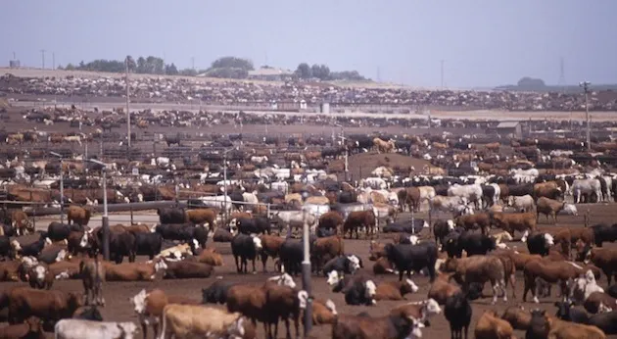
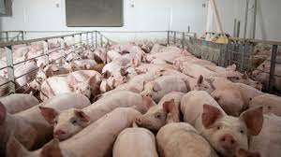

Slide 7
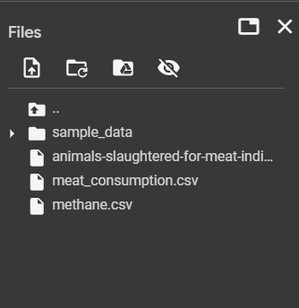

Slide 8
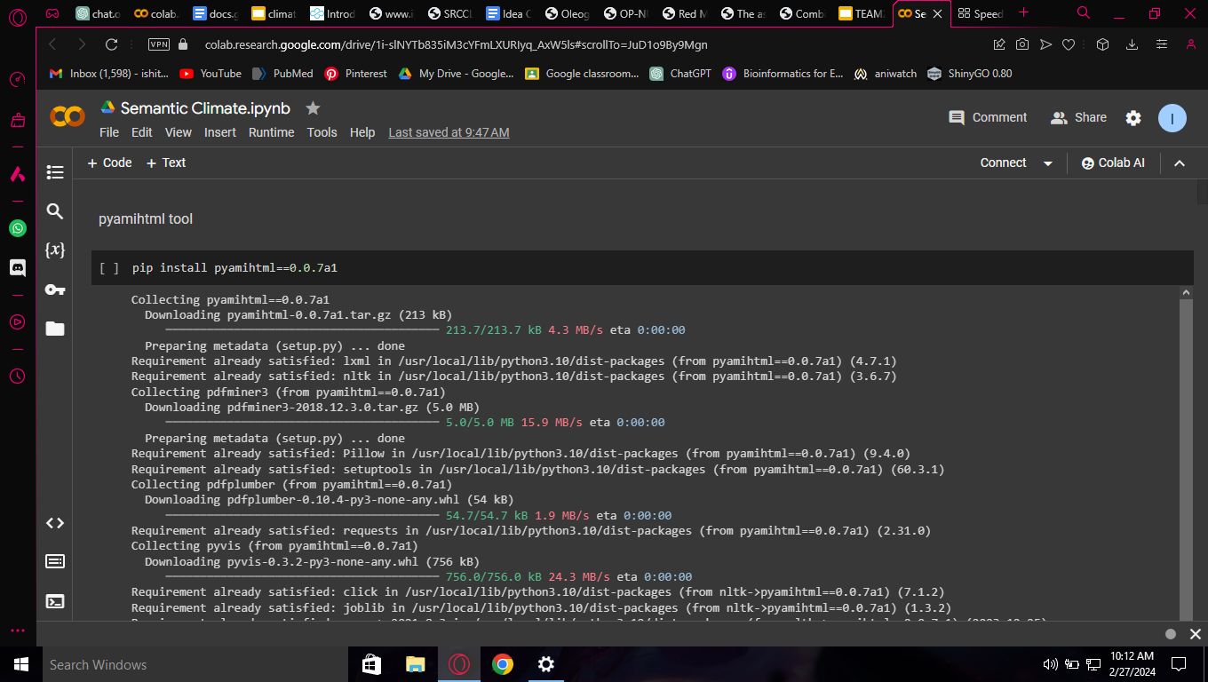

Slide 9


Slide 10
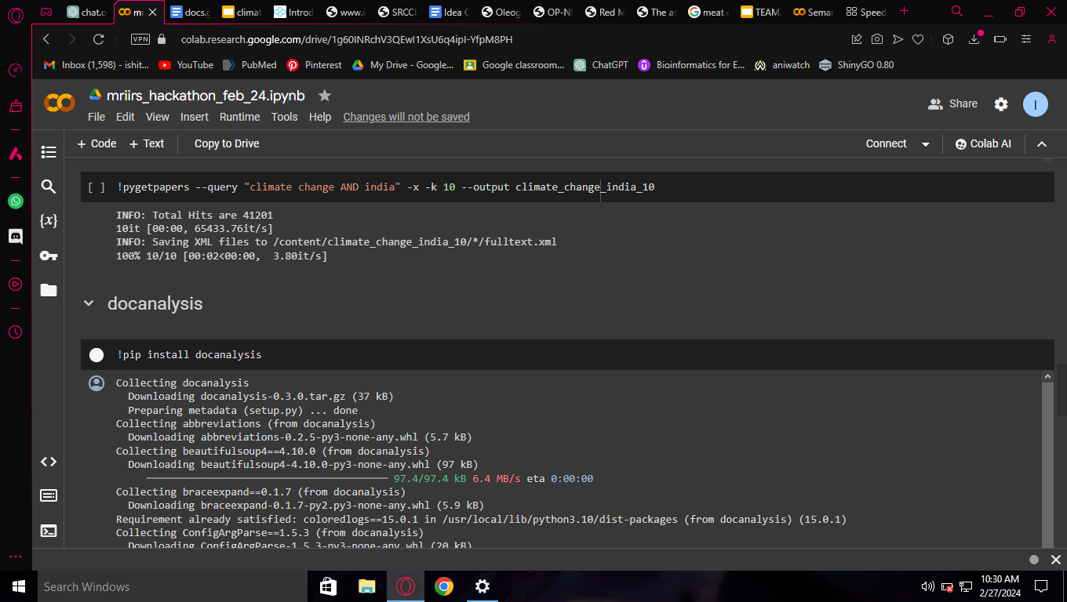

Slide 11
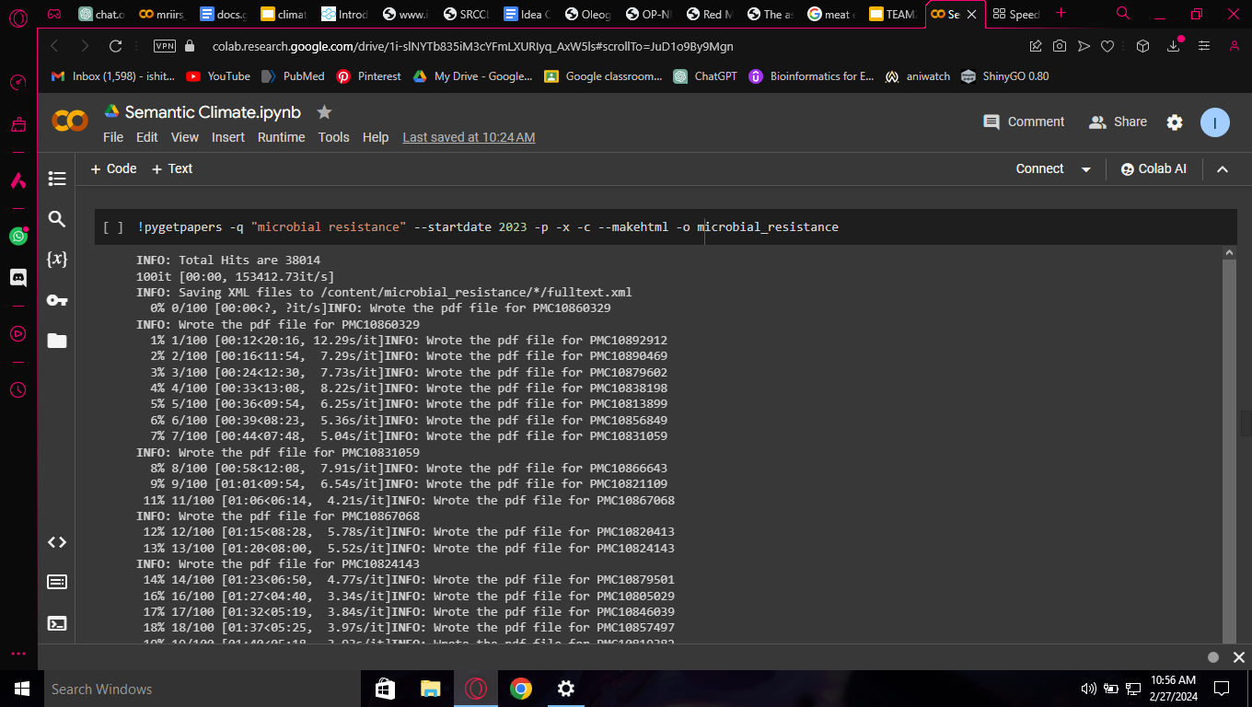

Slide 12
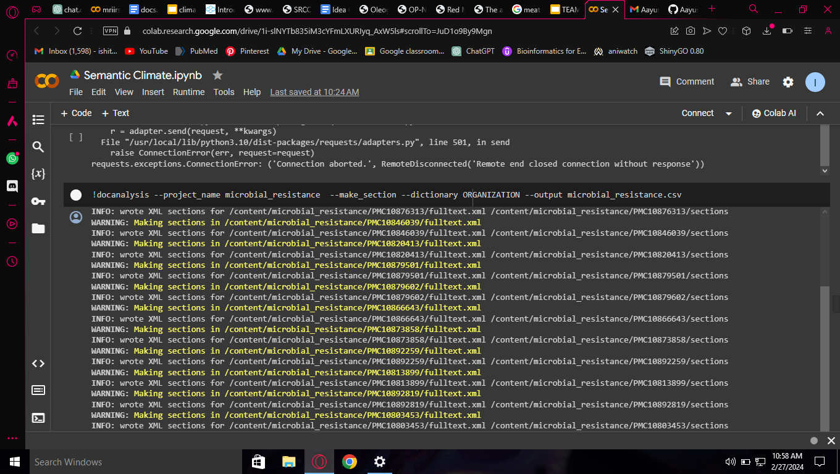

Slide 13
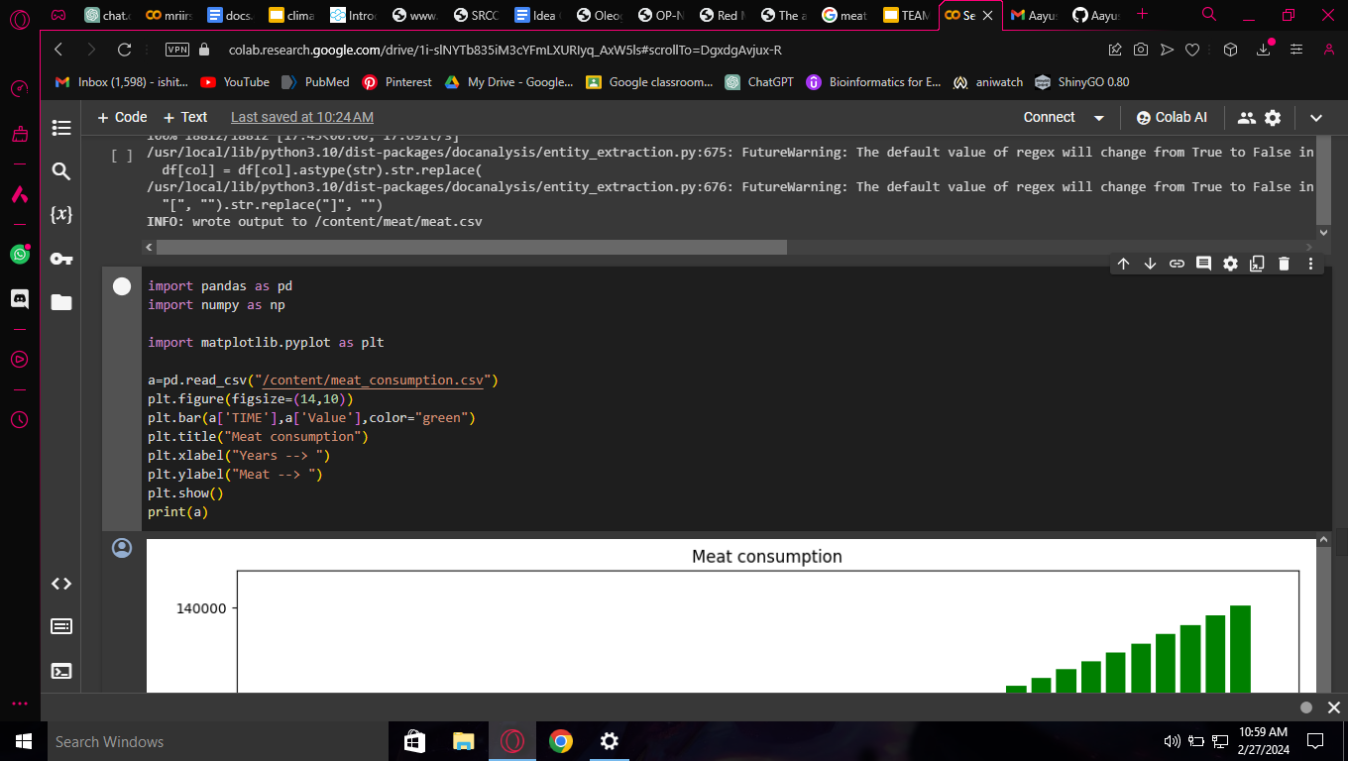

Slide 14
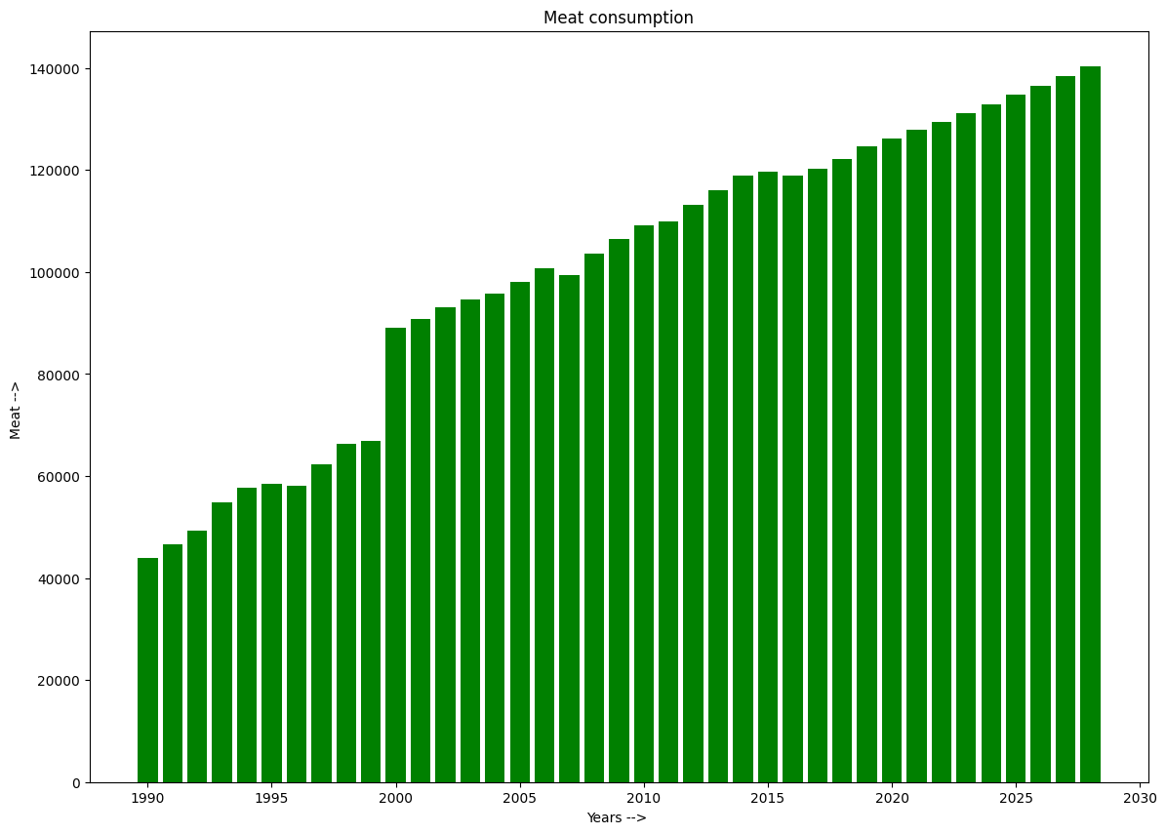

Slide 15
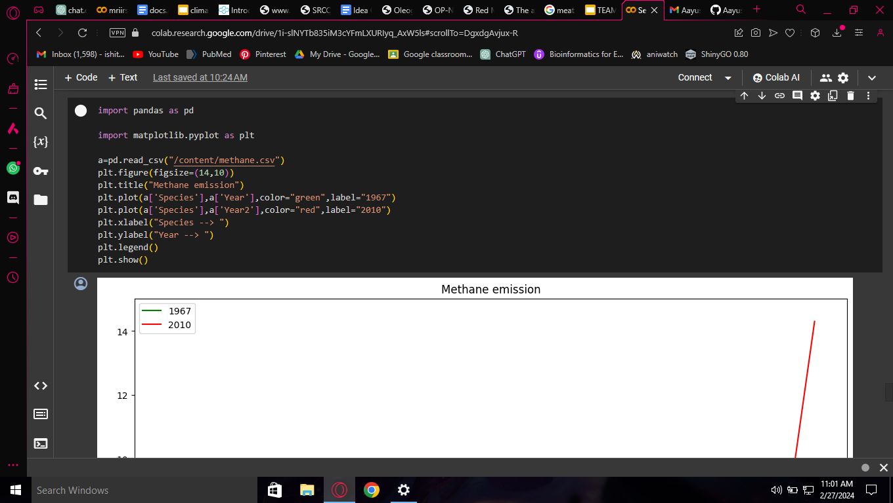

Slide 16
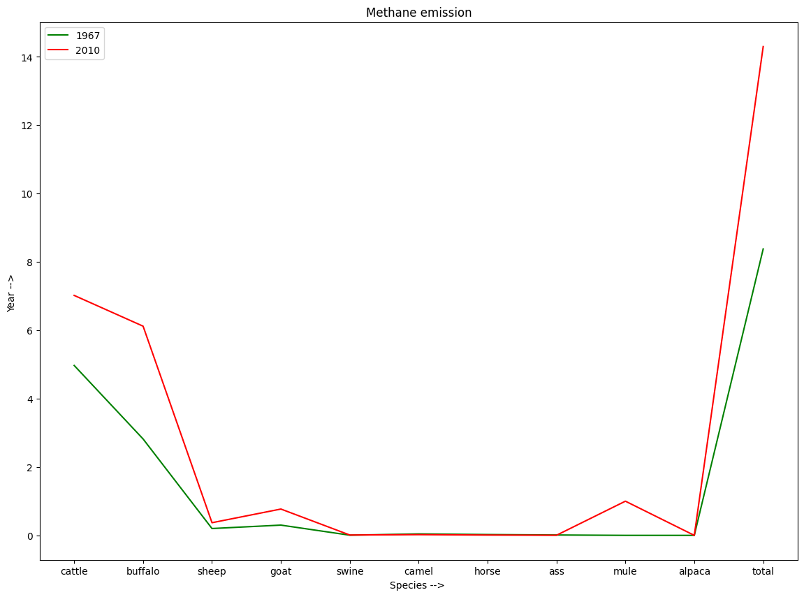

Slide 17
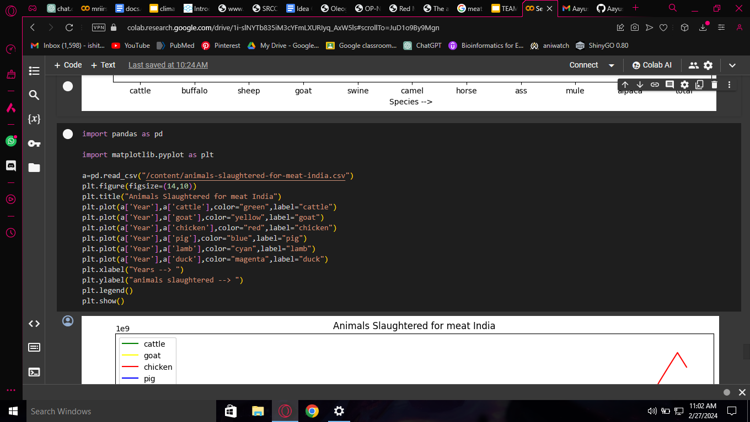

Slide 18
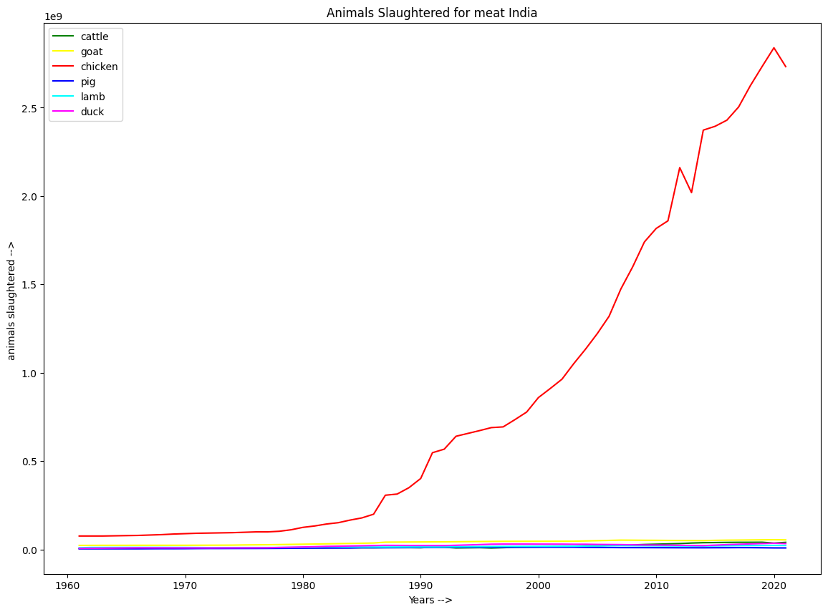

Slide 19
Link to our GitHub Repository-
Link to our Google Colab-
https://github.com/Aayush6377/Climate-Crusaders
https://colab.research.google.com/drive/1i-slNYTb835iM3cYFmLXURIyq_AxW5ls#scrollTo=JL9D1by3KgsX#scrollTo=JL9D1by3KgsX

Slide 20


Slide 21
